Slide 1


The Importance of Philosophy of Science in Science Education
Intern: Eyan Weissbluth
Mentor: Dr. Tuna Yildirim
Funded through the NASA Space Grant Program

Slide 2
Overview
What is Philosophy of Science
Motivation behind project
How data was collected
Results

Slide 3
What is Philosophy of Science
The study of foundational ideas of science
Begins with the ancient Greeks
20th century marked a shift in the field

Slide 4
Motivation Behind Project
Science itself is applied natural philosophy
To “do” science requires a conceptual understanding
Felt a lacking in current curriculum

Slide 5
Survey/Test Building
Do you think different fields in science use different scientific methods or is there a universal scientific method?
Initial idea was an open ended test
Moved to multiple choice test
Settled on a self evaluating survey
Given Hume’s skepticism about causality, what is the philosophical implication of his argument for the problem of induction?
a) It challenges the assumption that past experiences can justify predictions about the future.
b) It confirms that inductive reasoning is a logically necessary process for knowledge.
c) It asserts that causality is a metaphysical necessity independent of experience.
d) It establishes that empirical observation alone is sufficient to prove universal scientific laws.

Slide 6
Final Version
How would you rate your knowledge of philosophy of science?
How would you rate your knowledge of Karl Popper's contributions to philosophy of science?
What are some philosophical issues in your field?
Have you encountered any of issues you mentioned above in your research?
How would you go about addressing these issues?

Slide 7
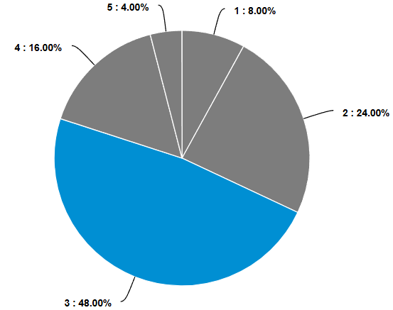
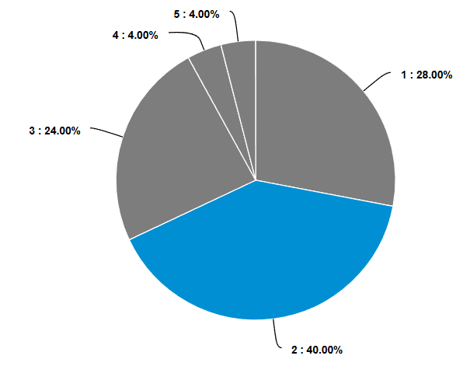
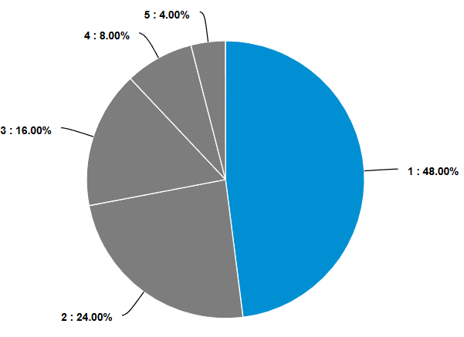
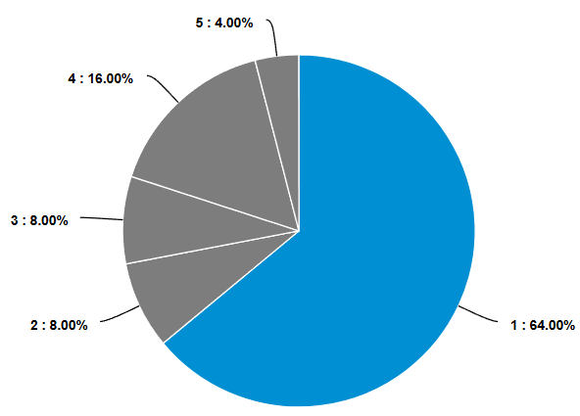
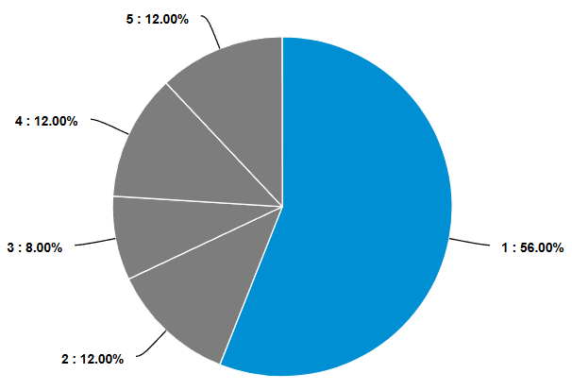
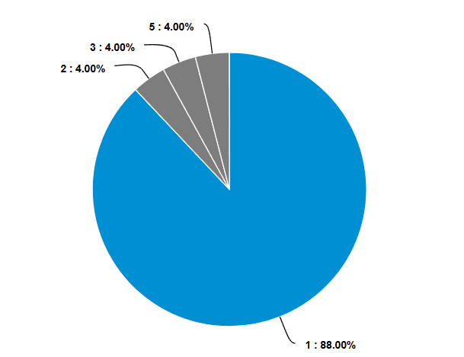
Results
How would you rate your knowledge of philosophy of science?
How would you rate your knowledge of Immanuel Kant's contributions to philosophy of science?
How would you rate your knowledge of René Descartes' contributions to philosophy of science?
How would you rate your knowledge of Karl Popper's contributions to philosophy of science?
How would you rate your knowledge of Thomas Kuhn's contributions to philosophy of science?
How would you rate your knowledge of Imre Lakatos' contributions to philosophy of science?

Slide 8
Free Response Section
What are some philosophical issues in your field?
Do fundamental particles exist outside of their interactions with other particles?
Is space an emergent property of something more fundamental?
Whether the risk to Earth of biological contamination is worth the gain from Mars sample return.
Should things that are unobservable, even in principle, be considered "scientific"?
How should one think about falsifiability, in relation to whether a theory/paradigm is "scientific"?
Is observational science really science, or does it have to be framed as testing a hypothesis?
Literally the meaning of life (in the technical sense)
What is time? What happens inside a black hole? How did the universe begin?

Slide 9
Free Response Section
How would you go about addressing these issues?
When teaching physics include its history.
Encourage students to ask, “How do we know what we know in physics?”
Reading literature, discussions with colleagues, discussions with students
For questions of definition and uncertainty I usually appeal to empiricism and pragmatism. For justification I prefer to an appeal to human purpose and intrinsic value of existence.

Slide 10
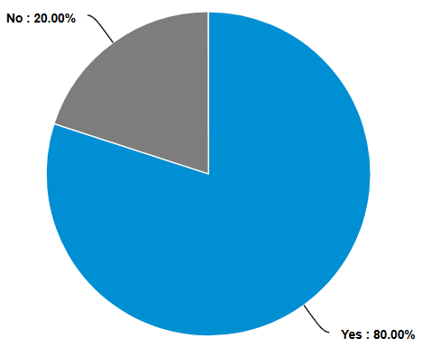
Do you think a better philosophy of science education would help addressing the philosophical issues in your field?

